Slide 1
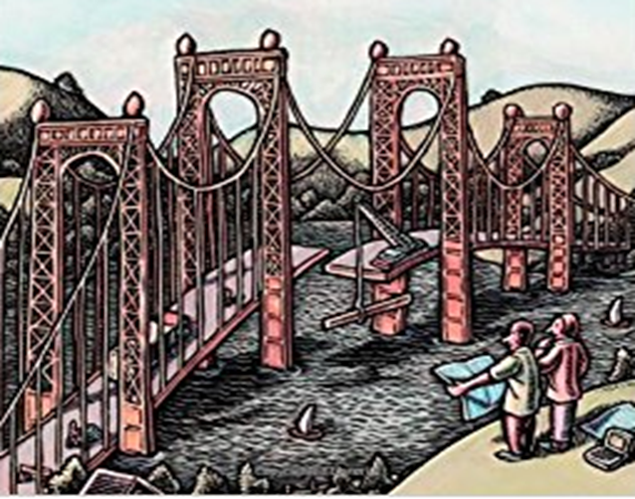
CLASS DIAGRAM

Slide 2
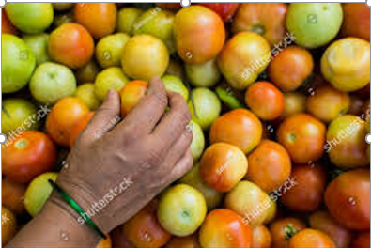
Class Modelling to Solve a Problem

Slide 3
Class Models Recap :
We discussed on the context of using UML and designing a system using Object Oriented approach
We discussed on the different models which we would consider as part of the same.
Static models - Class Model, Component Model and Deployment Model
Behavioral models - Activity Model, Sequence Model and the State Model
We discussed terminologies regarding system, models, views and diagrams
We then discussed on the objects in the problem space its characteristics, class and its characteristics, Class diagrams and relationships between classes as Associations whether Aggregation or composition, Generalization, Dependency and Realization
We used some examples to understand these concepts

Slide 4
Consider an ATM Case Study
Design the software to support a computerized banking network including both human cashiers and automatic teller machines (ATMs) to be shared by a consortium of banks. Each bank provides its own computer to maintain its own accounts and process transactions against them. Cashier stations are owned by individual banks and communicate directly with their own bank’s computers. Human cashiers enter account and transaction data.
Automatic teller machines communicate with a central computer that clears transactions with the appropriate banks. An automatic teller machine accepts a cash card, interacts with the user, communicates with the central system to carry out the transaction, dispenses cash, and prints receipts. The system requires appropriate recordkeeping and security provisions. The system must handle concurrent accesses to the same account correctly.
The banks will provide their own software for their own computers; you are to design the software for the ATMs and the network. The cost of the shared system will be apportioned to the banks according to the number of customers with cash cards.

Slide 5
Building this Class model for an application would have activities as
Use the problem description/use cases and find the Classes
Prepare a data dictionary
Find associations
Find attributes of objects and links
Organize and simplify classes using inheritance
Verify that access paths exist for likely queries
Iterate and refine the model
Reconsider the level of abstraction
Group classes into packages

Slide 6
1. Classes : Finding Classes
List candidate classes found in written description of the problem
Guidelines
Classes need to be extracted from problem domain
Some may be concreter and others may be abstract
Some may be explicitly stated by users/requestors/existing documents and others may be implicit
General rule start looking for Nouns for identifying classes
Notes:
Adjectives may be subclass or attribute
Verbs may refer to operations or relationships
Conjunctions and prepositions express relationships
Verb phrases often represent associations

Slide 7
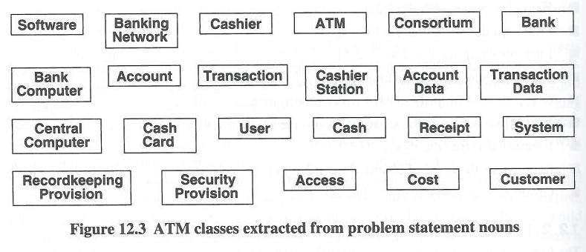
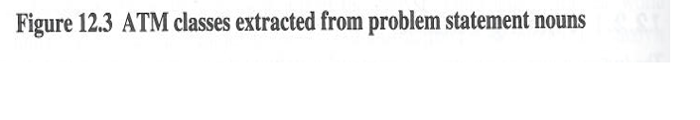
1. Classes : Finding Classes : Identified Classes for the ATM Example

Slide 8


1. Classes : Keeping the right Classes
Identify and Eliminate classes that are
Descriptive names which can give an indication Eg. Security Provision
Redundant Eg. For ATM example .. Customer and User
Irrelevant Eg. Cost say of an ATM machines (outside Scope)
Vague Eg. Transaction record inlieu of Record keeping provision
Attributes – these are things identified with nouns and are attributes of classes but not classes. Eg. AccountData is an attribute of Account
Operations applied to objects not manipulated on its own right. Eg. Call .. Date, time, origin destination
Role - The name should indicate an intrinsic nature and not a role that is played. Consider subtypes of say a person .. Could be employee, boss, spouse (a person being a person and not a role)
Eliminate Implementation constructs - Avoid things like data structure, trees. Arrays, process, algorithm, interrupts etc. Eg. Communication lines and Transaction log
Derived Classes - As a generic rule we can avoid those classes which can be derived from others.
Notes:
Adjectives may be subclass or attribute
Verbs may refer to operations or relationships
Conjunctions and prepositions express relationships
Verb phrases often represent associations

Slide 9
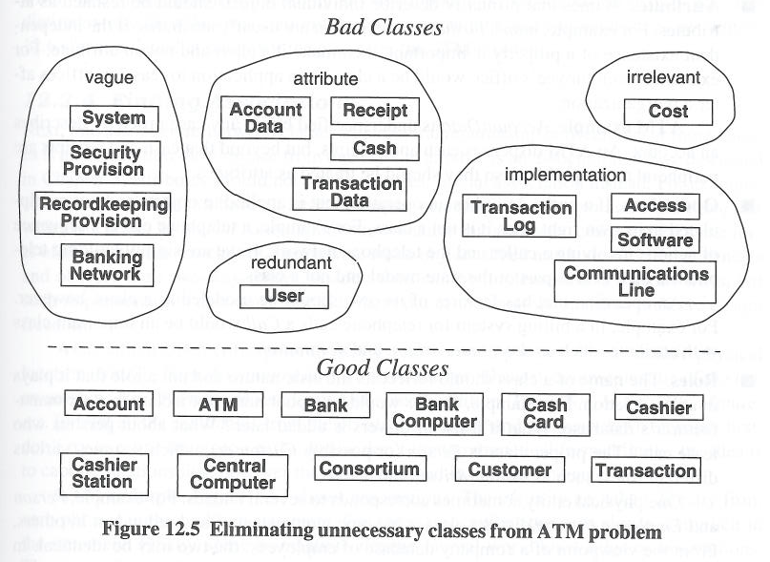
1. Classes : Keeping the Right Classes for the ATM system

Slide 10
1. Classes : Identified good Classes for the ATM system

Slide 11
2. Data Dictionary : Preparing a Data Dictionary
Given that independent words used for classes and can be interpreted differently and can have different meanings, a dictionary is prepared with a description as will be interpreted in the example context.
From the O-O perspective it should be possible to write a concise description of all valid classes
This will need to describe the scope of the class within the current problem including assumptions or restrictions on its use
This also shows the associations, attributes, operations and enumeration values
The relational requirement is more concrete specially to make a list of tables and all fields of those tables. Thus this will identify the meanings of the fields and what domains they are on.

Slide 12
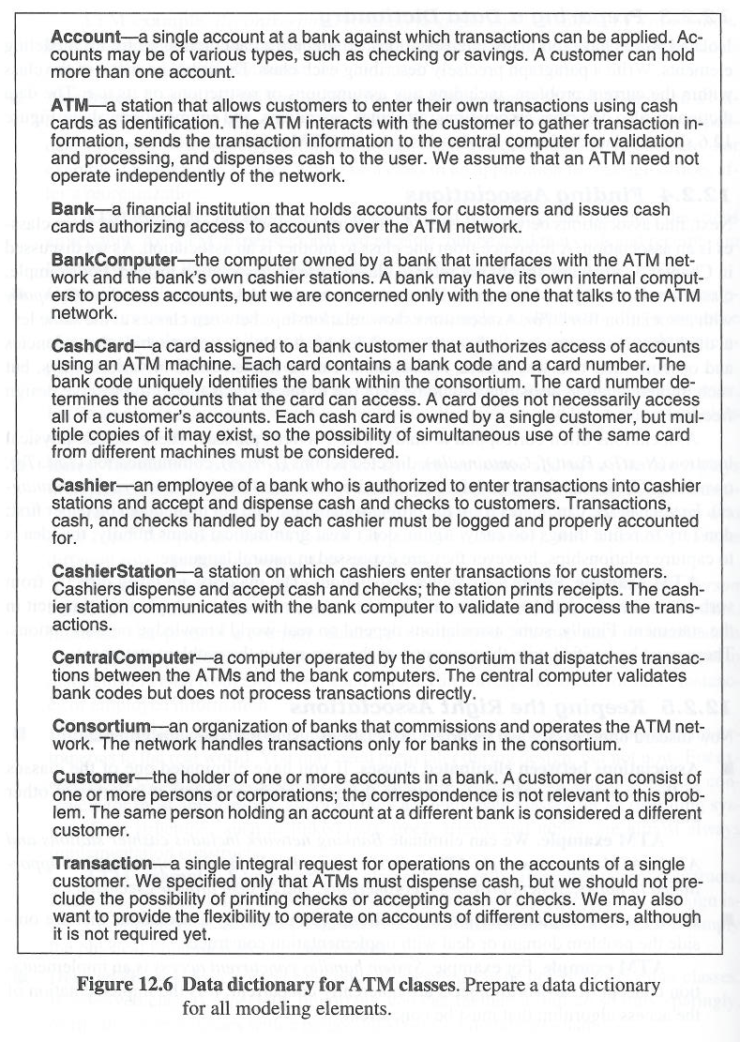
2. Data Dictionary : Data Dictionary (Example)

Slide 13
3. Class Associations : Finding the Associations
Association should describe structural property of application domain and not a transient event
Associations in a problem domain may be identified by verbal phrases e.g. NextTo, part of, ContainedIn or Drives, TalkTo, Has, WorksFor, Manages, includes, shares, provides etc.
Its to find a specific “has-a” relationship rather than “is-a”
A reference from one class to another is an association
Eg. class Person should not have an attribute employer .. There needs to be a relationship between class Person and class Company with association “worksfor”
Find and extract from the problem statement the explicit and implicit verb phrases and list them. Use the Knowledge of problem domain to help.
Notes:
ATM accepts CashCard – can be ignored
Avoid them and model them as binary associations
Two types – associations derived from other associations (GrandParentOf) – based on conditions on attributes (YoungerThan)
Identify Association End names and qualified associations
Pay attention to multiplicity but don’t over do it
For some applications, aggregation is important (orderitem in an order) for others it may be minor

Slide 14
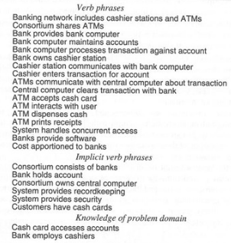
3. Class Associations : ATM System:
Verbal Phrases from ATM System domain for identification of Associations

Slide 15
3. Class Associations : Keeping the Right Associations
Eliminate associations between eliminated classes
Associations with eliminated classes has to be eliminated eg. Relationship with Banking Network, ATM interacts with User
Eliminating Irrelevant or implementation associations
Implementation concerns to be eliminated eg. System handles concurrent access
Actions which handle transient processing events
eg. ATM accepts cash Card. ATM interacts with User etc.
Ternary Associations
As much as possible, decompose associations among 3 or more classes into binary associations (could be as qualified association) eg. Bank computer processes transactions against accounts to Bank computer processes transactions and Transactions concerns account
Derived Associations
Omit associations that can be defined in terms of other associations eg. Consortium shares ATMs can be Consortium owns central computer and Central computer communicates with ATMs
Notes:
ATM accepts CashCard – can be ignored
Avoid them and model them as binary associations
Two types – associations derived from other associations (GrandParentOf) – based on conditions on attributes (YoungerThan)
Identify Association End names and qualified associations
Pay attention to multiplicity but don’t over do it
For some applications, aggregation is important (orderitem in an order) for others it may be minor

Slide 16
3. Class Associations : Pruning the Associations based on the Semantics
Misnamed associations
You eliminate them if they are redundant.
You rename them if they’re valid and not redundant.
Names should state what a relationship is, not be based on how it came about or some other extraneous description.
Eg. “Bank computer maintains accounts” describes an action can be renamed to “Bank holds accounts”
Association end names
Consider end names and it can be eliminated in case of it being obvious Eg. ATMs communicate with central computer .. the end names are obvious
Qualified associations
Qualifying an association ensures names which can be repeated can be identified in that specific context Eg. The qualifier bankCode distinguishes the different banks in a consortium.
Multiplicity
Ensure that cardinality of 1 is challenged and relooked

Slide 17
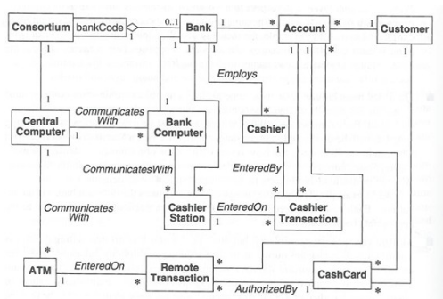
3. Class Associations : Initial class diagram for ATM System

Slide 18
4. Class Attributes : Finding Attributes
Attributes are data properties of individual objects
Attributes can be identified as nouns followed by possessive phrases eg. color of the car or position of the cursor. If we can say the noun as car, the color of car.
Attributes may not be completely described in the problem description and will need to be drawn from the knowledge of the domain and the application.
Attributes can be found from similar application or systems
Those which are not needed to be independently existing should be an attribute eg. birth date, weight
Omit derived attributes (e.g. age)
And others like Qualifiers, Identifiers, Association Attributes
Eg. ATM example: AccountData is likely an attribute of an account
Notes:
Identifiers – class identifiers which uniquely identify objects like TransactionID are not required to be modelled
Internal values – internal state values of an object need to be omitted
Boolean – reconsider and see if more values are associated with that attribute, in such cases, remodel it as an enum

Slide 19
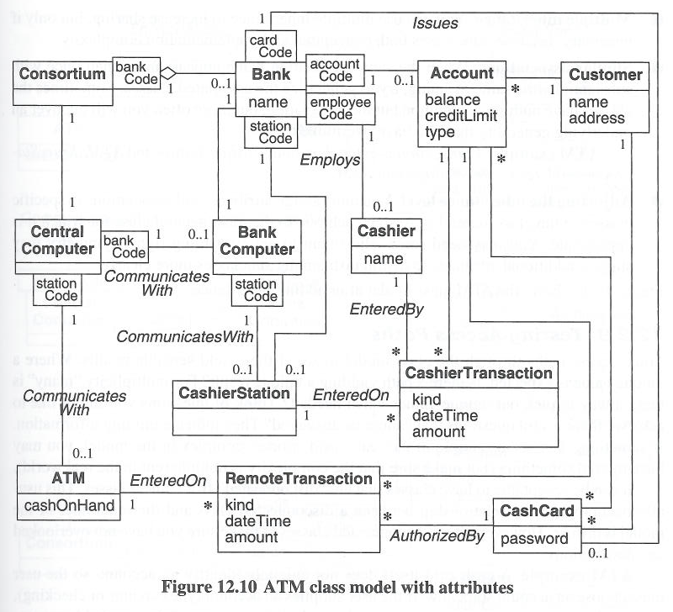
A Class Model with attributes

Slide 20
Refining Class diagram with Inheritance
The class diagram can be further organized to share common structures through inheritance as generalizing common aspects of existing classes or specializing existing classes into multiple subclasses. These are typically as
Bottom-up generalization
Top-down specialization
Eg. Remote transaction and Cashier transaction are similar which can be generalized into Transaction
Notes:
Look for common aspects in different classes and create a superclass with common features
Look for adjectives in noun phrases. Ex. Fixed menu, pop-up menu, sliding menu
Decide when to generalize and when to use enumeration. In some cases enum is enough.
Use sparingly
When similar association names exist, try and generalize the associated classes
Assign the right attributes to the right classes

Slide 21
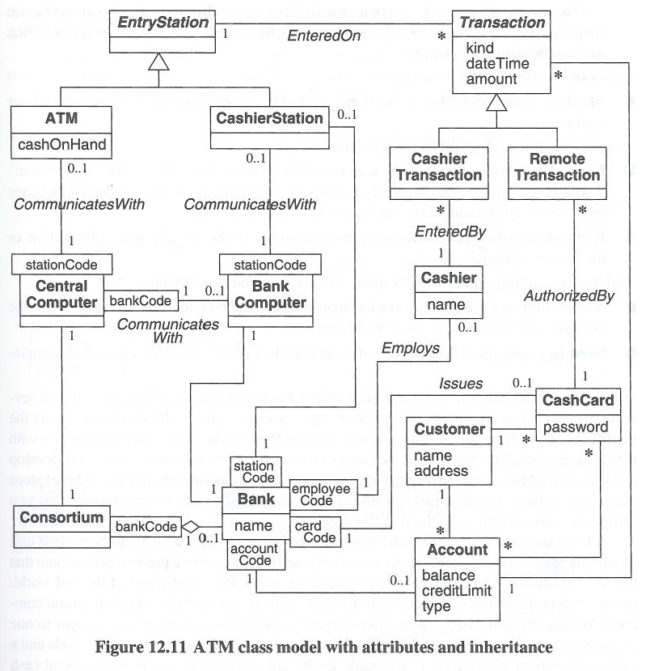
Refined Class Diagram

